Slide 1
Artificial Intelligence Introduction and History
Gerardo Ayala
2017
Dr. Gerardo Ayala

Slide 2
Cognitive Sciences
Artificial Intelligence is part of the
Cognitive Sciences:
Philosophy: logic, beliefs, knowledge.
Psychology: perception, reasoning, learning.
Linguistics: semantics (best example of AI)
Neuroscience: neural networks
AI
Dr. Gerardo Ayala

Slide 3
AI Objectives
Developing artifacts
able to
perceive, reason and learn.
Modelling cognition,
so we can understand
how we perceive,
how we reason
and how we learn.
Dr. Gerardo Ayala

Slide 4
Are we thinking machines?
Please tell us:
Are you a thinking machine?
or
Are you not a thinking machine?
Why?
Dr. Gerardo Ayala

Slide 5
Thinking machines?
What is Thinking?
Data processing?
or
Symbol manipulation?
¿Does the computer only processes data
or also manipulates symbols?
Dr. Gerardo Ayala

Slide 6
When do we use AI?
When there is no algorithm that provides the solution of a problem directly. We need an intelligent program that searches for a solution.
When we want our program to perform the appropriate action in a given situation.
When we want our program to recognize a pattern.
When we want our program to discover patterns.
When we want our program to improve its performance (learn).
Dr. Gerardo Ayala

Slide 7
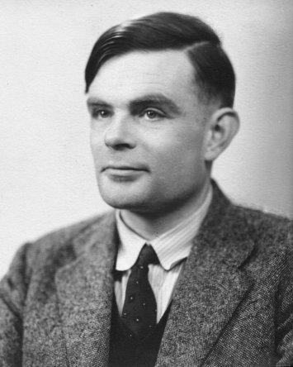
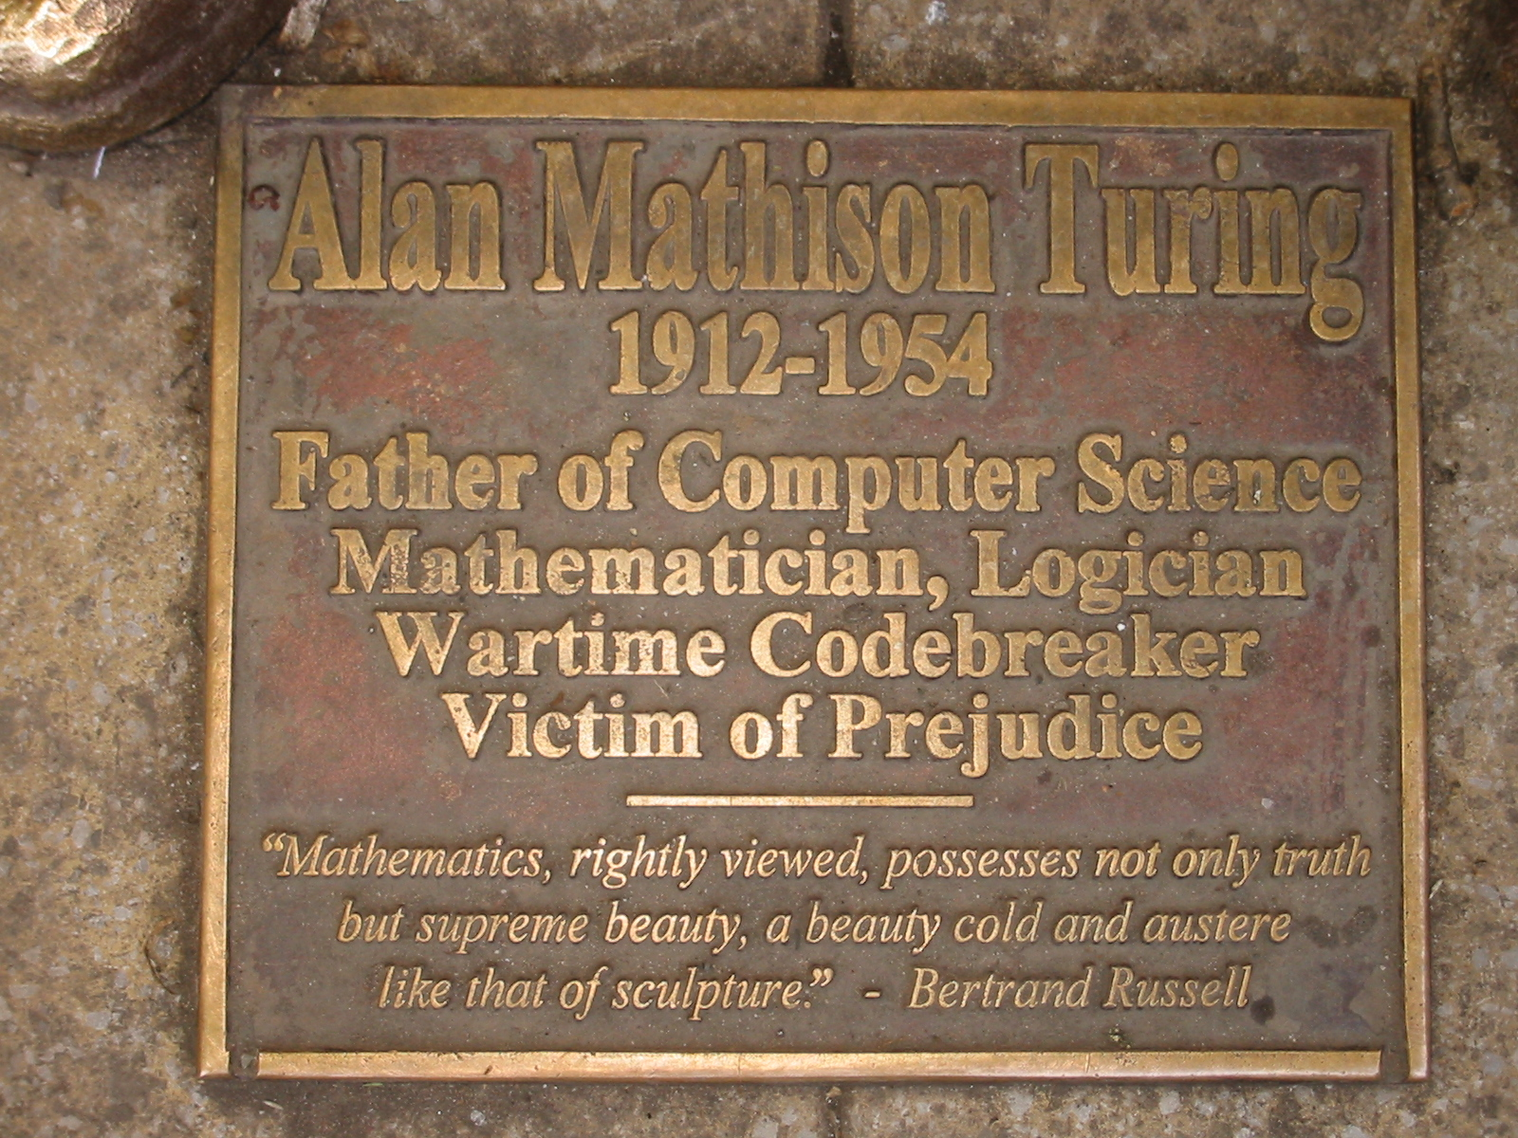
Alan Turing
Dr. Gerardo Ayala

Slide 8
The imitation game
The movie…????
Dr. Gerardo Ayala

Slide 9
The imitation game
Three players:
a man, a woman and an interrogator.
The man (A) and the woman (B) are outside the room where the interrogator and all people are.
The interrogator asks questions to them, by written messages.
The interrogator tries to determine which of one of the two players is the woman.
If the interrogator is correct, the woman wins, otherwise the man wins.
Dr. Gerardo Ayala

Slide 10
The Turing Test
Based on the imitation game.
Turing proposes a computer instead of the man
(player A).
If the interrogator fails,
then we can say that
the computer is intelligent.
here, intelligence is…
to say the correct thing in a given moment.
To perform the appropriate action
in a given situation.
Dr. Gerardo Ayala

Slide 11
Machine intelligence
Alan Turing
1950
“Computer machinery and intelligence”
First paper on Machine intelligence
Dr. Gerardo Ayala

Slide 12
Can you speak Japanese?
íma dóko? -------------→
náni o shíte íru? -----→
omóshiroi désu ka? →
yá, máta né-----------→
dáigaku da yó
íma bénkyou dés
amári omóshiro kunái
máta aimashóu
Can you understand Japanese?
Dr. Gerardo Ayala

Slide 13
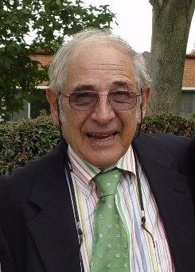
John Searle
Dr. Gerardo Ayala

Slide 14
The Chinese Room
By Searle.
Suppose that: 1. A computer passes the Turing test, and
2. The written messages are written in Chinese characters.
a) Does the computer understand Chinese?
or
b) Does the computer appear to have the ability to understand Chinese?
About the Chinese room
Dr. Gerardo Ayala

Slide 15
A pair of videos…
Daniel Dennett, about the Turing test
Watson
Dr. Gerardo Ayala

Slide 16
Is it just appearence?
Using AI techniques
we can develop artifacts…
that are intelligent
or
b) that appear to be intelligent.
is it real intelligence?
is it simulated intelligence?
Dr. Gerardo Ayala

Slide 17
Strong AI
A computer
well programmed,
and with the appropriate input data,
would have a MIND
in the same sense
as the human mind.
But..
in the Chinese Room
there is only syntax processing
no semantics!
Dr. Gerardo Ayala

Slide 18
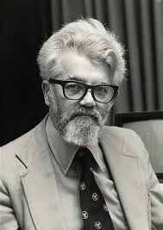
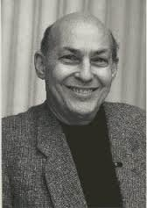
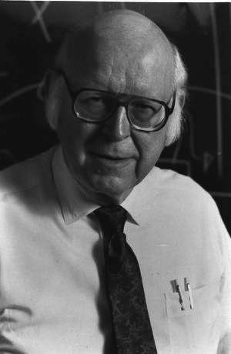
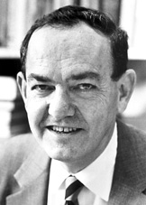
Just people, like you and I
John McCarthy Marvin Minsky
Allan Newell Herbert Simon
Dr. Gerardo Ayala

Slide 19
The meeting at Dartmouth College
1956
Summer research project on AI.
Artificial Intelligence is the ability to SOLVE PROBLEMS.
Problem Solving is SEARCHING for a solution.
It implies:
1.- A Search Space
2.- A Search algorithm
3.- Heuristics to guide the search (not to be a blind search)
Dr. Gerardo Ayala

Slide 20
Games as microworlds to test problem solving
Chess programs.
Search space: HUGE!
Aprox. 1000,000,000,000,000,000,000,000,000,000,000,
000,000,000,000,000,000 possible situations.
Search must be SELECTIVE, not blind.
A heuristic search is intelligent.
Dr. Gerardo Ayala

Slide 21
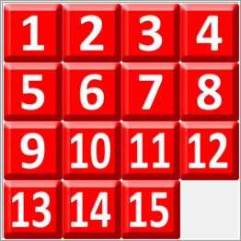
The 15 puzzle search space
Number of possible situations:
10,461,394,944,000
(size of the search space)
Suppose we require 16 int values to represent a situation (64 bytes) and we need to represent all…then…
We need 66.95 Terabytes
Suppose we require 1 ms to analyze one situation, and we will analyze all…then…
We need 331.72 years

Slide 22
The General Problem Solver
GPS, 1959.
By Newell and Simon.
It could play chess and solve mathematical theorems.
It was a “Logic Machine”
It uses a knowledge base as a SET OF RULES, independent of the problem solver engine.
It uses the means-ends-analysis as searching strategy
Dr. Gerardo Ayala

Slide 23
Means-ends-analysis
Initial state.
Final state (goal).
Current state.
Set of possible actions to be applied to states.
Process:
An action that can be applied to the current state is selected, in order to go from the current state to a new state. The selection criteria is to reduce the distance between the current state and the final state.
Perform the selected action and reach a new current state.
IF the current state is not the final state then go back to step 1; ELSE stop.
Dr. Gerardo Ayala

